Slide 1
Crab age prediction
Rafif Dwiputra

Slide 2
Objective
Predict the age of crab
dataset
The dataset is used to estimate the age of the crab based on the physical attributes.

Slide 3
goal
For a commercial crab farmer knowing the right age of the crab helps them decide if and when to harvest the crabs. Beyond a certain age, there is negligible growth in crab's physical characteristics and hence, it is important to time the harvesting to reduce cost and increase profit

Slide 4
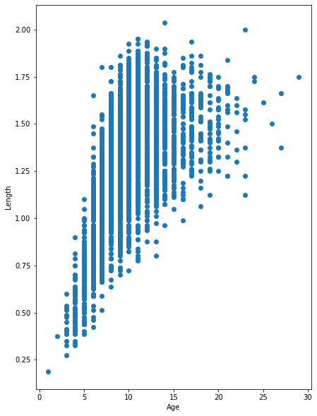

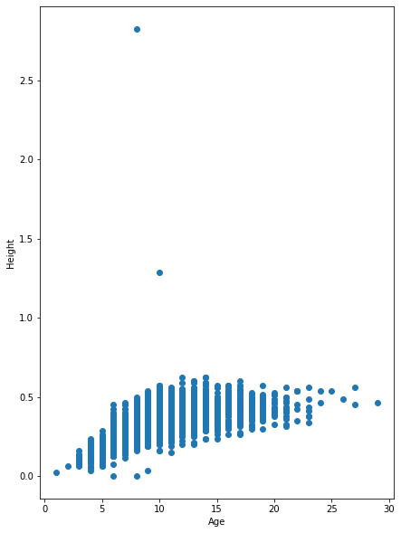
Exploratory Data Analysis (EDA)
Length
Diameter
Height
From the scatterplot we can see that age has a correlation with other features, although not too much correlation.

Slide 5
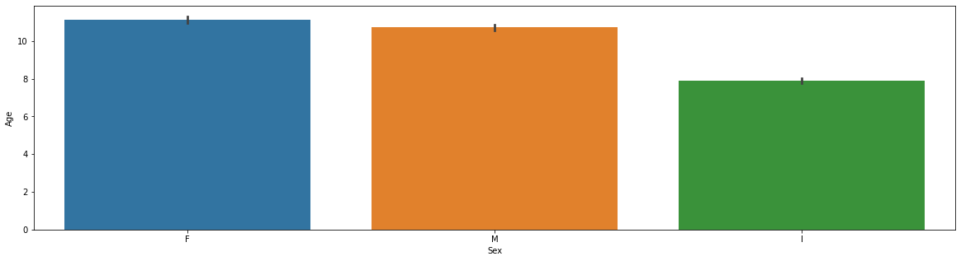
Exploratory Data Analysis (EDA)
The Crab with Female gender life longer than male and infertebrata crabs.

Slide 6
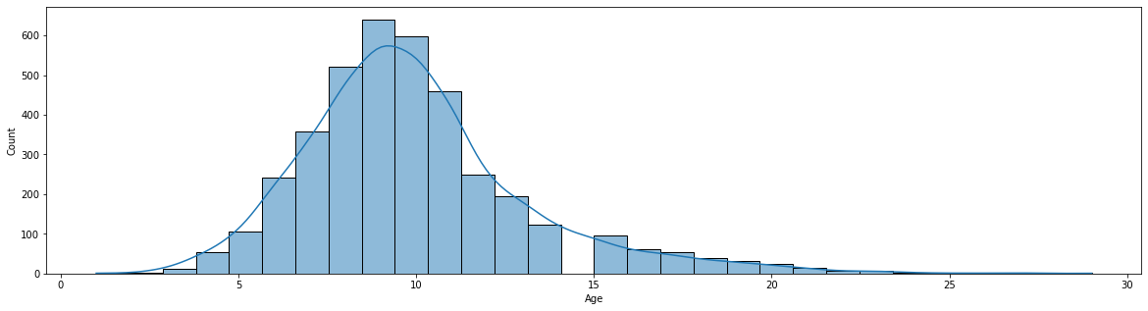
Exploratory Data Analysis (EDA)
From the histogram plot of the dataset, we can see that the average age distribution of crabs is between 8-10 months old.

Slide 7
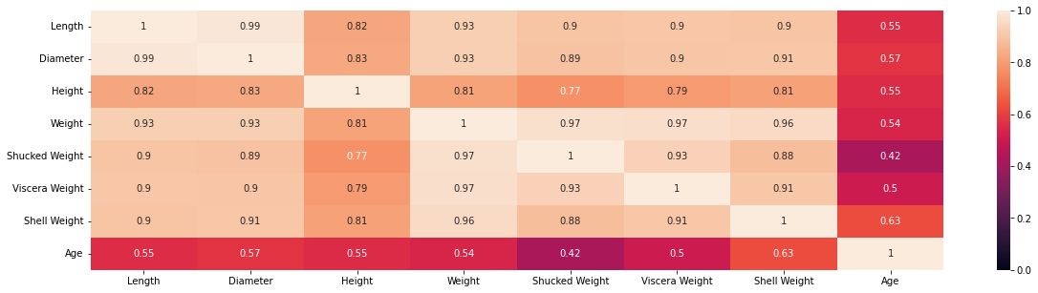
Exploratory Data Analysis (EDA)
From the heatmap, we can conclude that the correlation between columns has a fairly high correlation, where the values ​​between the columns are almost close to 1, which is closer to 1, the higher the correlation.

Slide 8
Model
Linear Regression
Elastic Net
Ridge
Lasso
Lars

Slide 9
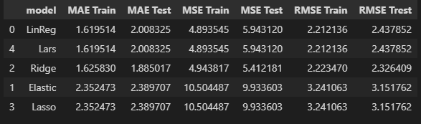
Model definition
- From the MSE, the Linear Regression Model has the lowest error value and the difference between the Train and Test is not too far from the 1.6 month Train and 2.47 month Test.
- From the MSE, the Linear Regression model has the lowest error value among the other Train data, but the difference from the Test is quite large.
- From the RMSE, the Linear Regression model has the smallest value for the Train data.

Slide 10
Model inferencce

Slide 11
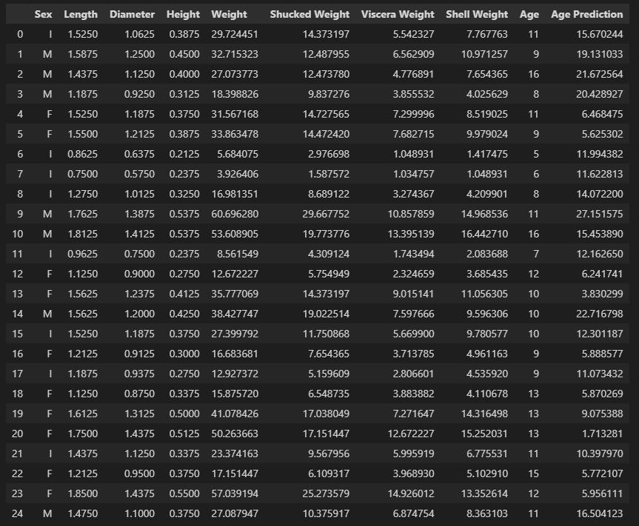
from inference data, the model can predict the age of the crabs, but there are still some data that are wrong
DESIGN
RESEARCH

Slide 12
-From the Scatterplot we can conclude that the features and targets have a fairly high correlation, but they are inseparable from the presence of outliers in some columns. - From the Heatmap it can be concluded that it is true that the columns in the dataset have a fairly high correlation between the columns. - From the data above, the best model was chosen, namely Linear Regression, with the MAE between Train and Test only slightly different, the lowest MSE and lowest RMSE.
CONCLUSION

Slide 13
THANK YOU

